Slide 1

Team 6 Project Presentation
Cameron Chambers, Cedric Rutijana, Ricardo Gonzalez Mendez, Zuhdi Abujayyab, Yubin Hu, Zixi Rao

Slide 2
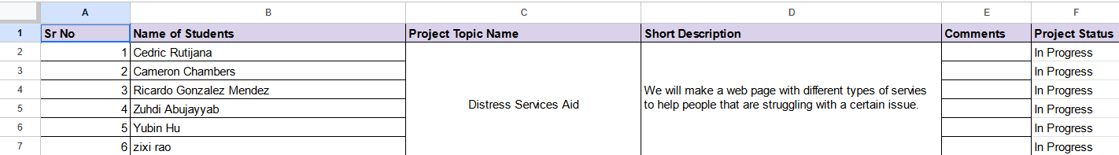
Project Roles for Team Members
Below is an outline of our team members, as well as their positions:
Cameron – Project Manager
Cedric – Developer
Ricky – Designer
Zuhdi – Developer
Yubin – Content Specialist
Zixi – SEO Consultant
*Project status has been updated in Drive

Slide 3
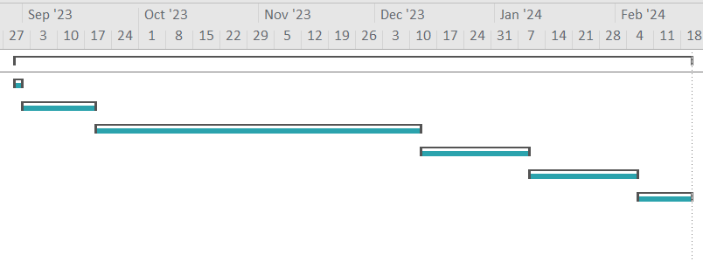
Current Progress + Future Plans
So far, we have accomplished the following:
Assign project roles
Develop skeleton for website
Meet weekly to make progress
Built estimate documents
Over the next two weeks, we plan on achieving the following:
Make substantial progress on website build/development
Begin server-side setup
Work on search bar functionality

Slide 4
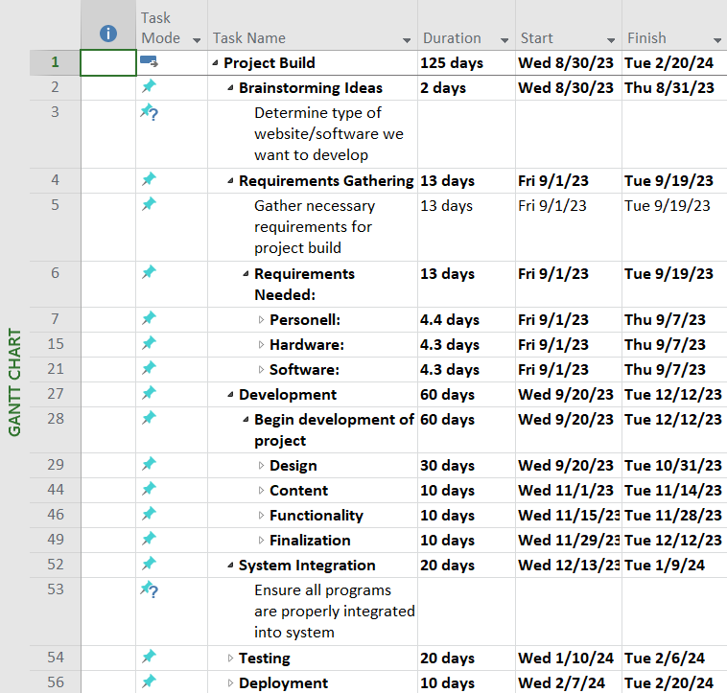
Project Time Estimate
Attached is a screenshot of a rough outline for the time requirements of our project:
Brainstorm ideas for software development project
Determine and gather necessary requirements for project
Begin developing website for project
Ensure all programs are properly integrated into system, and work well with server
Test website to ensure functionality runs smooth
Deploy project to general project

Slide 5
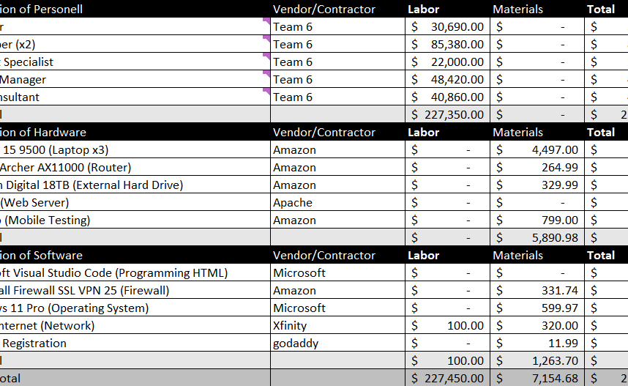
Project Cost Estimate
Attached is a screenshot of a rough outline for the cost requirements of our project:
Personnel Costs – $227,350.00
Hardware Costs – $5,890.98
Software Costs – $1,363.70
Will need to account for any extra costs that may arise

